Slide 1
Columbus North Counseling Center
Welcome Future Juniors!

Slide 2
GOAL
To present course selections for your junior year.
Students will use their computer to access the 2019-2020 Course Catalog to help with their course selections, diploma requirements, testing requirements and other graduation requirements.

Slide 3
WHAT CLASSES SHOULD I TAKE?
English, Math, Science and US History are all required during your junior year.
C-4 classes: never too late to start! Do you plan to continue?
Questions see Mrs. Weichman
ASK CURRENT TEACHERS FOR RECOMMENDATIONS!

Slide 4
Diploma Requirements

Slide 5
COURSE CATALOG
This year the course catalog is strictly online.
The following two slides will demonstrate how you can access the course catalog on the Counseling Center’s It’s Learning page.

Slide 6
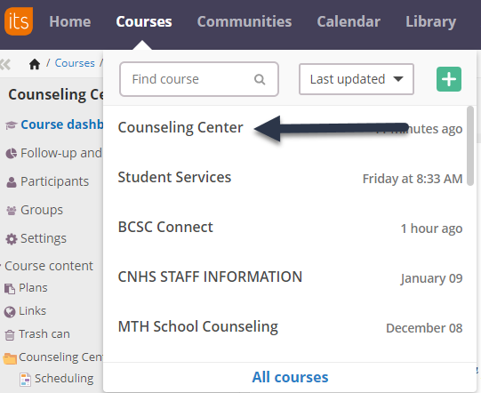
Course Catalog: Go to Counseling Center Course in It’s Learning

Slide 7
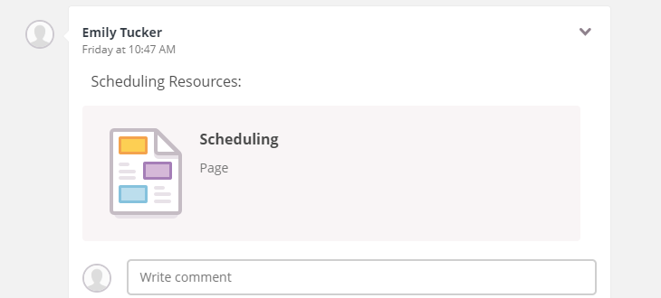
Click “Scheduling Resources” in the Center of the page:
Click on “2019-2020 Course Catalog” on the right side of the page:

Slide 8
Completing the front page…
Be sure to:
Fill in every item on the front of the form
Pay special attention to Name, ID, Phone #, & the scheduling grid & fill in EVERY box including 3 alternates!
If you take C4--Allow space in your grid for 2 & 3 period C4 classes
Things to remember:
All diploma requirements (retake any missed or failed classes)
Follow teacher recommendations
Prerequisites
The grid does not indicate what period you will have the class

Slide 9
FRONT PAGE

Slide 10
Completing the inside…
Mark only the box for each class that you have written in the grid on the front page (not any extra)
Some year-long classes require you to mark the box for BOTH 1st semester & 2nd semester
Other year-long classes require only one mark-those are labeled (2 sem)

Slide 11
Inside Cover

Slide 12
Visits to your English classes
SOPHOMORE SCHEDULE FOR COURSE SELECTIONS:
February 11: McInteer 1, 3, 5, & 8
February 12: Dowling 1, 3, 4, 5, & 7
February 13: Caldwell 4 & 6; Warble 2 & 7
February 14: Sanders 6 & 8
February 15: Handt 2 & 3; Culp 8

